Slide 1
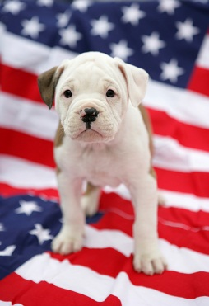
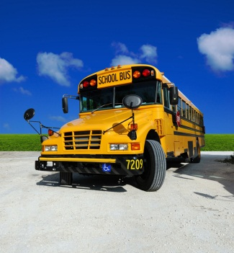

Welcome Parents!!
Mrs. Porte’s Third Grade Class
2017-2018
Please take a seat at your child’s desk.

Slide 2

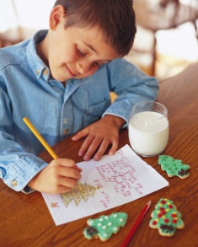
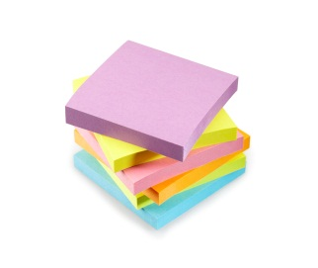
Communication
Communication is an important part of third grade success. I will communicate with you through a weekly newsletter. I will send a hard copy home every Monday. You can e-mail me any time at aporte@ofsc.net or call me at 440-427-6497. You can also write me notes in the assignment notebook/planner, I check them every morning. I will check phone messages at, the end of the school day. I will also check my e-mail at lunch time and at the end of the school day.*Email is the best way to contact me!

Slide 3

Class List
Class List Mrs. Porte 2016-2017
Claire Binder
Adam Coyne
Carli Dailey
Marissa DeCaprio
Aubrina Duskey
Nicholas Elswick
Nate Erderlack
Ethan Fekete
Edward Greenfield
Shabby Hamad
Aubrey Jones
Ben Komitau
Jacob Komitau
Claire Mallory
Bradley Miller
David Monyak
Nathan Smith
Penelope Smith
Kallie Sperling
Olivia Strekel
Swarika Totapolly

Slide 4
Transportation
If your child is going home a different way than usual, you must write a note to school. This note will be sent to the office, then returned to the classroom. If we do not have this note the child must take their normal route home.
Your child’s safety is of upmost concern for Falls-Lenox. This is why we do not accept phone calls, faxes and relayed messages.
Thank you for helping us keep your child safe and secure!

Slide 5
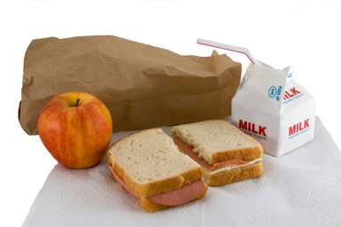
Food
Snacks
We will have a quick daily snack at 8:50 am. Please try to provide a snack each day. The students have almost four hours between breakfast and lunch and need the energy boost. Students can bring in a water bottle if they use it responsibly. If the snack requires a spoon or fork, please pack them.
Lunch
The students eat lunch at 11:10. The students may pack a lunch or buy a school lunch. Lunch menus are available on the district website. Please pack items that are easily opened by your child.

Slide 6


Important Times!
Bulldog Best
Birthdays
Each week, a student will be chosen as the Bulldog Best for our class. Students are picked for exceeding the school and class expectations of being safe, respectful, and responsible. They will have their name on the announcements, get their picture taken, and receive a certificate.
You may want to send in a small treat to celebrate your child’s birthday. Please notify me a head of time and send in all of the supplies needed to serve and enjoy the treat. We will also sing to your child. If students are having parties outside of school, please do not send the invitations to school unless the whole class is invited. This will save hurt feelings. If your child has a summer birthday we will celebrate their birthdays in May.

Slide 7
Homework/Assignment Notebooks
The binder and assignment notebook system is designed to help your third grader with organization and accountability. When students know what is expected and have a place for things they are successful and well prepared.
It is important that students return homework everyday but if your child is unable to complete his/her homework occasionally I understand. Please note that homework time should not exceed 30 minutes (excluding reading). If your child cannot complete the homework within thirty minutes, I will be available to help them with it at school the next day. Homework is meant to be practice and should not be a source of frustration for your child. The following schedule is a typical week’s worth of homework:

Slide 8
Homework Schedule:
Homework Schedule:
BDL – (Bull Dog Log) Students need to read AND record each night. They will record the book and time read. Parents will help record the minutes to date because students earn stickers each time they read 200 minutes. Parents must also sign their BDL each night. Another VERY important requirement on the BDL is practicing math fact fluency and spelling. This should take place and be recorded at least three nights a week.
Monday – BDL, Reading Comprehension
Tuesday – BDL, Bridges Math practice
Wednesday – BDL
Thursday – BDL, Bridges Math practice
Friday-Sunday-BDL
*Students can chose which nights to study math facts and complete a spelling activity. I will not be requiring them to hand in physical work but your signature will serve as evidence that they completed practice during the week. Students can also spend time on Compass Learning and Raz Kids for additional practice with reading and math skills.

Slide 9
Other Important Stuff
Reader’s and Writer’s Workshop:
Spelling Program
Your child will be participating in a word study program that is tailored to their needs. The students were given a developmental assessment to gain knowledge of their needs and strengths. On their assigned day, students will take a test to assess their word knowledge. Throughout the week students will practice these words in various ways during the Working with words block. They should also practice their words at home throughout the week in addition to normal homework.
We will be working very hard this year to create a community of learners in our classroom. Students will be engaged in daily reading and writing as well as response to reading and writing through discussions, Book Talks, and Author Talks. I hope to create a learning environment in which all students can take pride and ownership in their learning and work toward setting and achieving personal reading and writing goals. Please support and encourage your child’s reading habit at home.

Slide 10

Scholastic Book Club
Please help our classroom earn free books by ordering from the Scholastic Book Club each month. The more books we order, the more points we earn which can be used to get books. Our classroom code is ND2L4 if you would like to order online.

Slide 11
Grades:
B= Beginning. This means your child still needs significant practice with this standard.
D= Developing. This means your child is able to successfully demonstrate this standard most of the time but still requires some practice to reach mastery.
S= Secure. This means your child can successfully demonstrate this standard all of the time and does not require additional support or practice.
Portfolios
All students will have a portfolio to showcase their work throughout the year and track their progress toward goals. I plan to send the portfolios home at the end of each trimester but if you would like to see it at any time during the school year just ask.

Slide 12
Math Fact Fluency
Math Fact fluency is very important in Third Grade. Students should come into Third grade fluent in addition facts. This means they can complete 100 addition facts in 5 minutes or less with 95% or above accuracy. In October we move on to subtraction Fluency. By the end of October/beginning of November students are expected to pass the 5 min. Subtraction assessment. Multiplication will be completed in January and Division in March. It is extremely important that you work frequently on math facts. These are the foundation for all math skills.
*Please monitor your child’s progress by checking their weekly math facts tests. These will be sent home on Fridays.

Slide 13
Volunteers
Volunteers are very important in the classroom. If you have any time to spare we would love for you to join us and would greatly appreciate it. You can help out in the classroom or at home. Please take the time to fill out the Volunteer Sheet. I will contact notify you shortly after you return the form to get your involved.
Here are a few ways you can help out:
Reading Helper – 2 parents needed (1 time per week for 20-30 min.)
Math tutor – 2 Parents needed (1 time per week for 20-30 min.)
Copying – 1 parent (1 time per week – 45 minutes)
Portfolio - (Once a month for 60 min.)
Math Facts Helper- 1 parent (1 time per week for 45 minutes)
At Home Helper- Pencil Sharpening and cutting (1 time per week for 45 minutes)

Slide 14
Class Schedule
https://docs.google.com/document/d/100emE78VAbqTbASfp7mfihyJ809FiZYZ-_mwmCUqRiA/edit

Slide 15

Google Classroom:
We will be using Google Classroom this year. All students will have access to our Google Classroom by logging on to Google using their email address. Students will be able to access classroom assignments through Google Classroom and parents can view work that students have completed in class.

Slide 16
Class Website mrsporteclass.weebly.com
Please visit our class website. You can type in the web address or access it through the Olmsted Falls City School District website by clicking on Teachers’ Websites, Falls-Lenox, then finding my name.
On the website, you can find links for students and parents.

Slide 17

Seesaw is an interactive, digital portfolio that students will be using weekly in class. Each student will have their own Seesaw portfolio that can be accessed using their Google email address. Students will be able to post videos, pictures of their work, and comment on other students’ work while using Seesaw. Parents can also subscribe to Seesaw to view and comment on all the wonderful work their child is doing each week. I also will use Seesaw to post current updates and messages as well as pictures and videos of classroom activities.
Please plan on connecting to Seesaw and checking it weekly. I will send home parent directions on how to access Seesaw during the first week of school.

Slide 18
Before you leave…
Sign up for a conference time.
Sign up to bring in party items for the Halloween and Valentine’s Day Party.
Take a Wish List Item.
Take all paperwork with you that was on your child’s desk.
Thank you so much for coming tonight. I look forward to building a strong partnership with you and your child.

